Slide 1

State Energy Codes and
ASHRAE Standard 90.1 Update
Presented By: Jeff Seewald
October 30, 2024
DISCLAIMER: This presentation is intended only for educational purposes and does not replace independent professional judgment and/or legal advice.
This presentation is copyrighted and cannot be used without the express permission of Daikin Applied Americas Inc.

Slide 2
Agenda
Topics
Key Takeaways
Introduction
  Energy Code Updates
  Compliance Paths
  History
  Impact
  Adoption
Key Changes
  Commissioning
  Building Envelope
  Mechanical & HVAC
  Electrical & Lighting
  ECB & PRM
Resources
Q&A
Several states updated the basis of their building energy codes to ASHRAE 90.1-2019
Commissioning requirements are substantially expanded
Envelope
  Whole building air leakage testing
  Continuous air barrier
Simplified approach for small buildings
  HVAC
  Lighting
Mechanical
  Across the board updated equipment efficiencies
Lighting
  Decreased lighting power density
  100% LED baseline
Increased scope and depth of controls requirements

Slide 3
Learning Objectives
In Scope
Out of Scope
This presentation is intended to offer:
An update on changes to state building energy codes
An overview of ASHRAE Standard 90.1-2019, with a summary of key substantive changes to the standard
Special focus on changes impacting mechanical and HVAC systems
This presentation does not offer:
A comprehensive and detailed treatment of changes to ASHRAE 90.1-2019, or incremental changes since ASHRAE Standard 90.1-2010
Substantial coverage of…
  Performance path compliance
  Commissioning

Slide 4


Introductions
Jeffrey Seewald, PE, CEM
HVAC Systems Business Development Manager
jeffrey.seewald@daikinapplied.com
Joined Daikin in November 2023
30 years of experience
    HVAC equipment and systems
    Building automation and controls
    Energy efficiency and infrastructure renewal
Focus areas at Daikin include:
    Decarbonization
    Refrigerants
    Electrification and heat pumps
    Energy efficiency
    Indoor air quality
    IAQP / SVT

Slide 5
Disclaimer
This content subject to change without notice and is intended only for educational purposes and does not replace independent professional judgment and/or legal advice. The ultimate responsibility is on the engineer of record to ensure the design complies with all applicable codes and Daikin Applied will not accept responsibility or liability for actions that result from the information shared in this presentation. This content is copyrighted and cannot be used without the express permission of Daikin Applied Americas Inc.
Always consult your state & local codes, which may take precedence over standards which vary in adoption, complete or partial, by state. Also note that a state may adopt a different year of the standard than the latest version.
The local Authority Having Jurisdiction (AHJ) has the final authority in interpreting code requirements. When in doubt, contact the AHJ.

Slide 6



Ohio
References ASHRAE 90.1-2019
References ASHRAE 62.1-2019

Slide 7
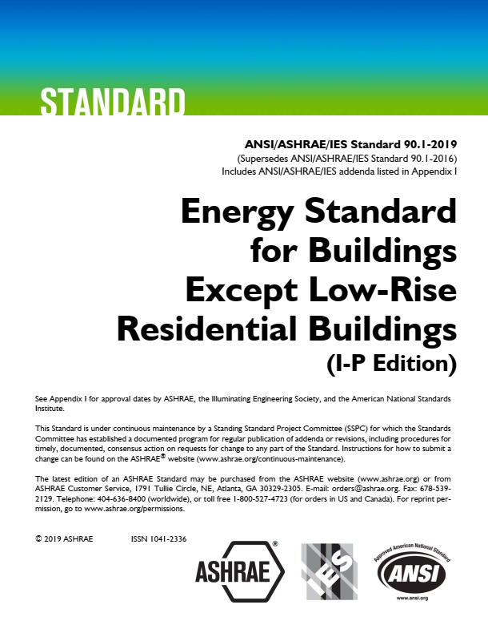
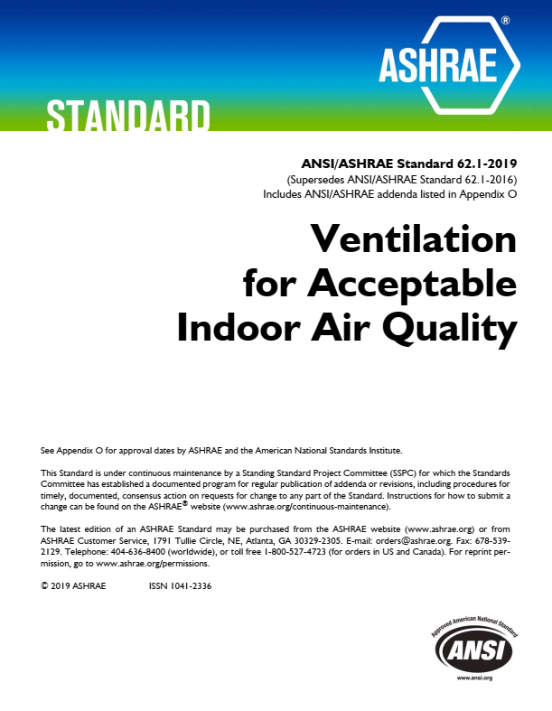
Building Codes
Ohio Building Code Makes a Leap Forward
Effective March 1, 2024:
All projects going out for permit in Ohio will need to comply with both:
- ASHRAE 90.1-2019
- ASHRAE 62.1-2019

Slide 8
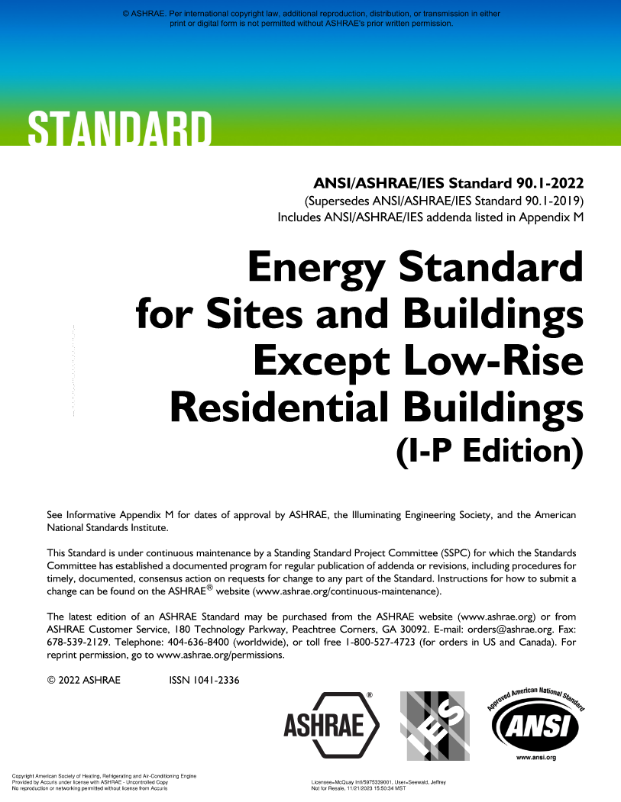
About ASHRAE 90.1
ASHRAE Standard 90.1, Energy Standard for Buildings Except Low-Rise Residential Buildings, specifies minimum requirements for energy efficient designs for buildings except for low-rise residential buildings.
ASHRAE Standard 90.1 defines two paths to comply:
Prescriptive, with requirements for building envelope, HVAC, domestic hot water, power, lighting, and other equipment
Performance-based, with two approaches, the Energy Cost Budget (ECB, Section 11) method, and the Performance Rating Method (PRM, Appendix G)
Latest version is 90.1-2022.
ASHRAE 90.1-2019 referenced by 2024 Ohio Building Code

Slide 9
About ASHRAE 90.1
Applies to:
New buildings and their systems,
New portions of buildings and their systems,
New systems and equipment in existing buildings, and
New equipment or building systems specifically identified in the standard that are part of industrial or manufacturing processes
Does not apply to:
Single-family houses, multifamily structures of three stories or fewer above grade, manufactured houses (mobile homes), and manufactured houses (modular) or,
Buildings that use neither electricity nor fossil fuel.

Slide 10
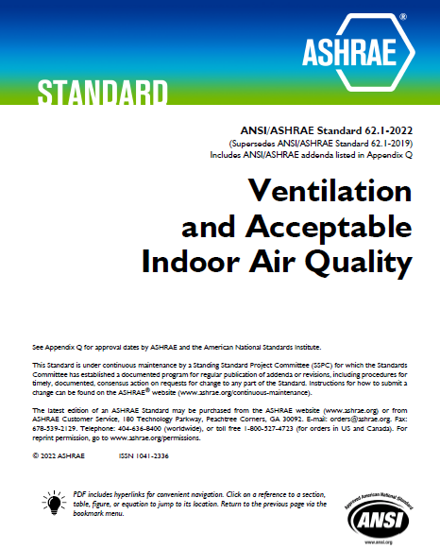
About ASHRAE 62.1
ASHRAE Standard 62.1, Ventilation and Acceptable Indoor Air Quality, specifies minimum ventilation requirements to provide IAQ that is acceptable to human occupants to minimize adverse health effects.
ASHRAE Standard 62.1 defines acceptable IAQ as:
Air that has no known contaminants at harmful concentrations, and
Where a substantial majority (80% or more) of the building occupants do not express dissatisfaction.
Note that ASHRAE Standard 62.1 is meant to deal with regular emission sources, sources that happen all the time. It is not meant to consider indoor air during a pandemic, a fire, or a bioterrorist attack.
ASHRAE 62.1-2019 referenced by 2024 Ohio Mechanical Code
Use SVT to comply with the IAQP!

Slide 11
ASHRAE Standard 90.1 Compliance Paths
Compliance Pathways
Documentation
ASHRAE 90.1 Prescriptive Path
ASHRAE 90.1 Prescriptive Path
Sections 5, 6, 7, 8, 9, and 10
Full construction plan set including drawings and specifications
w/ Envelope Trade-Off (Optional)
w/ Envelope Trade-Off (Optional)
Prescriptive
Allows trade-offs within Section 5.5
Documentation required for prescriptive path and;
COMcheck report
w/ Simplified HVAC Approach (Optional)
w/ Simplified HVAC Approach (Optional)
Section 6.3 (alternative to 6.4 & 6.5)
Documentation required for prescriptive path and;
Clear indication of intent to follow simplified approach
ASHRAE 90.1-2019
Building Code
ASHRAE 90.1 Energy Cost Budget Method
ASHRAE 90.1 Energy Cost Budget Method
Section 11 and Mandatory Provisions¹
Full construction plan set including drawings and specifications
Detailed list of energy efficient design features
Input and output reports from an approved energy simulation program
Performance
ASHRAE 90.1 Energy Performance Rating Method
ASHRAE 90.1 Energy Performance Rating Method
Section 4.2.1(c), Appendix G and Mandatory Provisions¹
Full construction plan set including drawings and specifications
Detailed list of energy efficient design features
Input and output reports from an approved energy simulation program
ASHRAE 90.1 Mandatory provisions include Sections 4, 5.4, 6.4, 7.4, 8.4, 9.4, 10.4
Approved energy simulation energy programs include but are not limited to eQUEST, EnergyPlus, and Trane TRACE

Slide 12
Performance Path Options
Method | Baseline
ASHRAE 90.1 Energy Cost Budget Method | Dependent | Baseline systems and components are same as proposed building, but at minimum, current prescriptive efficiency
ASHRAE 90.1 Energy Performance Rating Method | Independent | Baseline systems and components based on the architectural program and location of a building
 | Stable | Baseline set at efficiency ~ equal to 2004 standard with proposed design required to exceed the baseline
Both methods compare energy cost of a proposed building design to a baseline

Slide 13

Poll
In your estimation, what percentage of projects apply the prescriptive approach (over an energy modelling approach) to compliance?

Slide 14
History
ASHRAE Standard 90.1-
2001
2007
2010
2016
2019
2022
2004
1980
1989
1999
Origins of ASHRAE Standard 90.1…
ASHRAE Standard 90-1975 issued on January 14, 1975
1970s energy crisis sets the stage for energy efficiency
U.S. Department of Energy establishes ASHRAE Standard 90.1-2004 as the commercial-building reference standard for state building energy codes under the federal Energy Policy Act
National Bureau of Standards presents early building energy standard at ASHRAE winter meeting
ASHRAE Standard 90-2016 incorporates Performance Rating Method (Appendix G)
National Bureau of Standards starts work on Design and Evaluation Criteria for Energy Conservation in Buildings
1970s
1973
Jan
1974
Jan
1975
2000
2010
2020

Slide 15
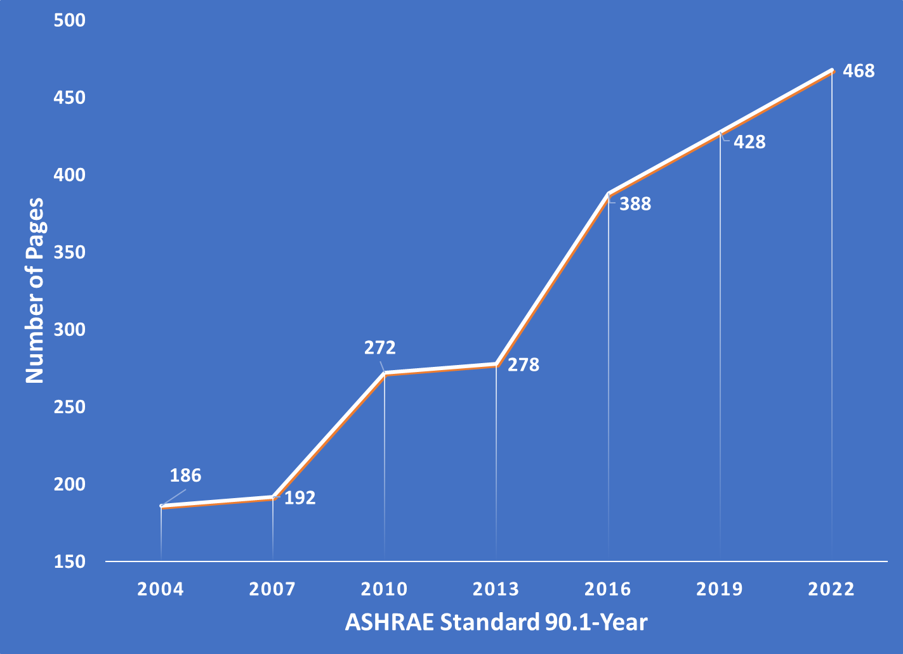
History
ASHRAE Standard 90.1

Slide 16
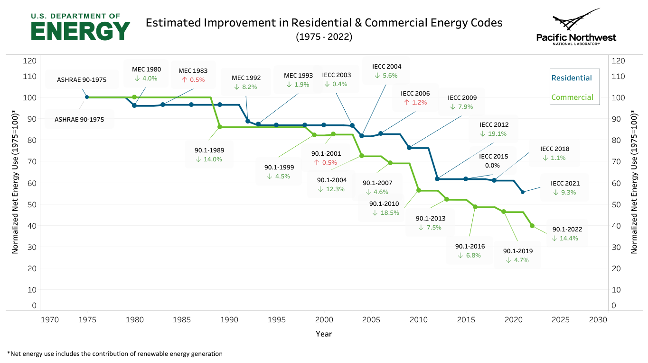
Impact
Source: Building Energy Codes Program (PNNL)

Slide 17
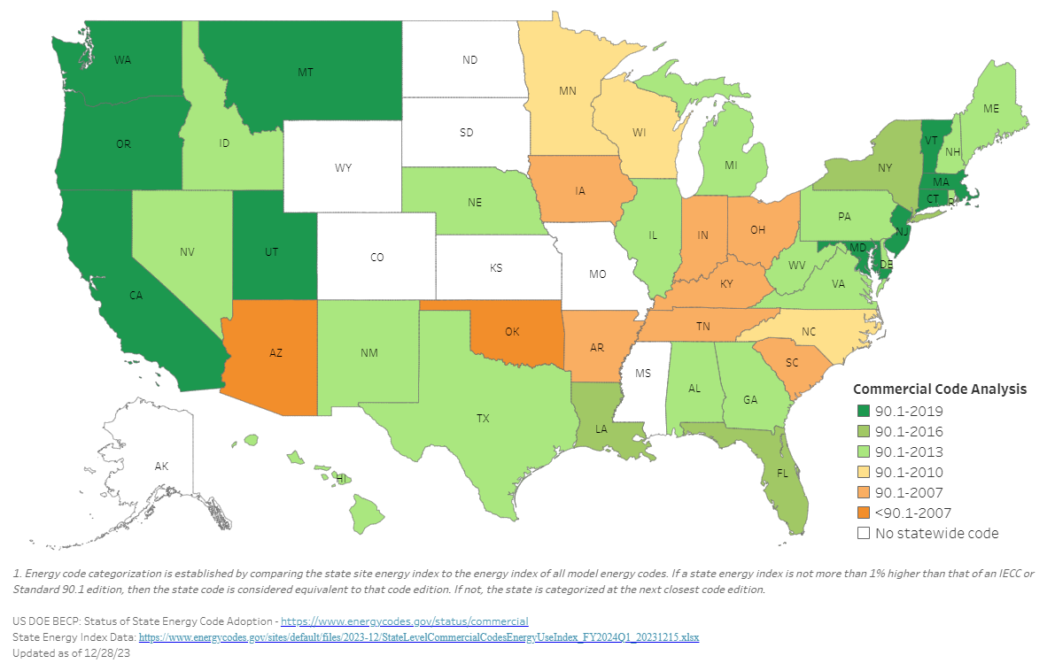
Energy Code Adoption by State
Status of State Energy Code Adoption: Commercial Buildings
Early 2024

Slide 18
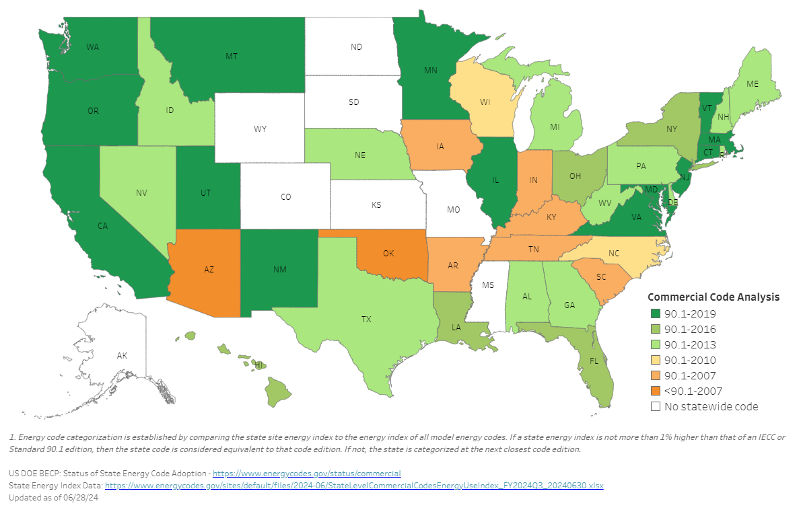
Energy Code Adoption by State
Status of State Energy Code Adoption: Commercial Buildings
June 2024
Energy code updated in:
Illinois
Minnesota
New Mexico
Ohio
Virginia

Slide 19
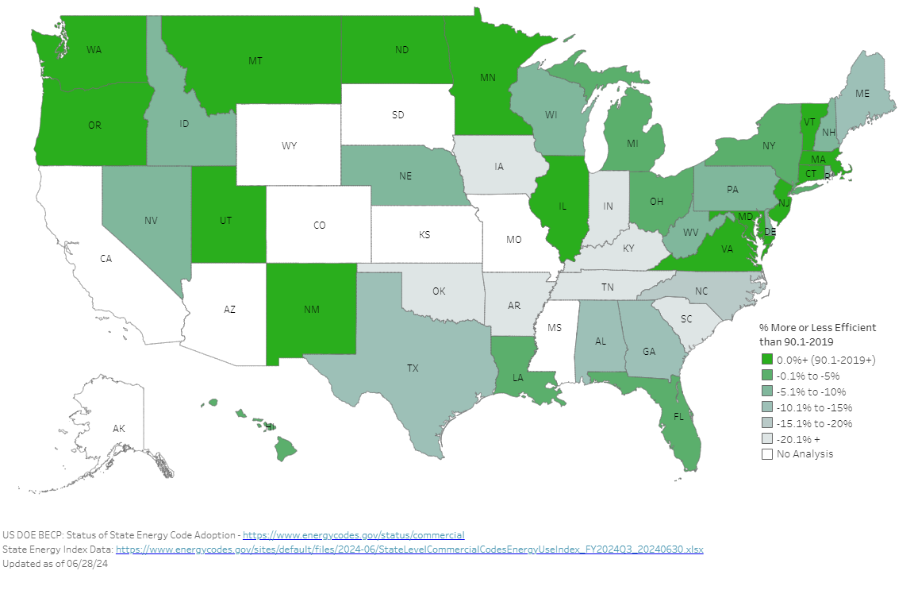
Energy Code Index by State
Commercial Energy Code: State Energy Index Relative to Current Model Code (90.1-2019)

Slide 20
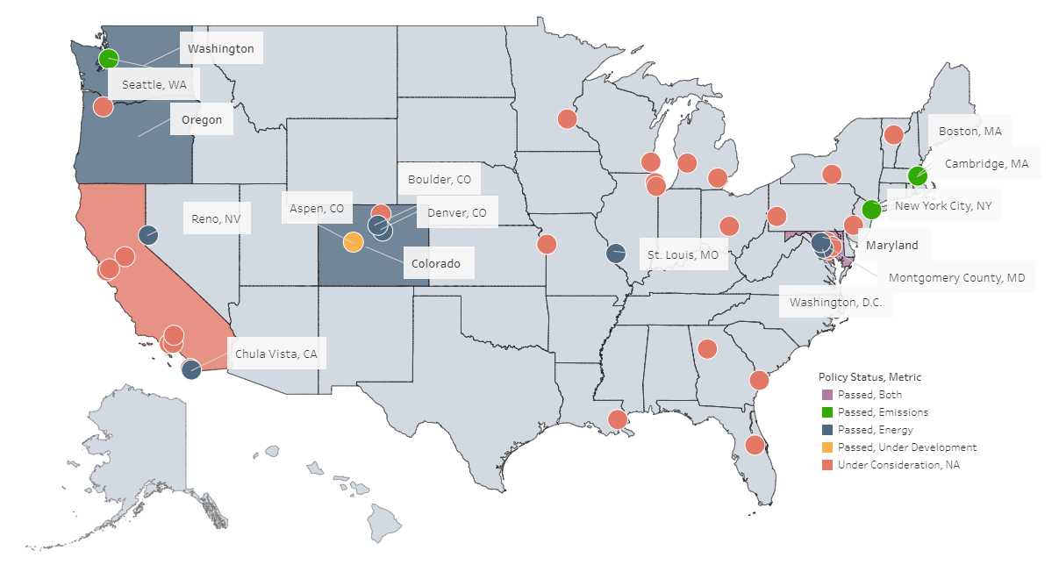
State/Local Building Performance Standards
Source: US DOE Building Energy Codes Program (July 2024)
©2024 Daikin Applied

Slide 21






Rating Systems

Slide 22
Poll
What percentage of building designs in your area employ green or healthy building rating systems?

Slide 23

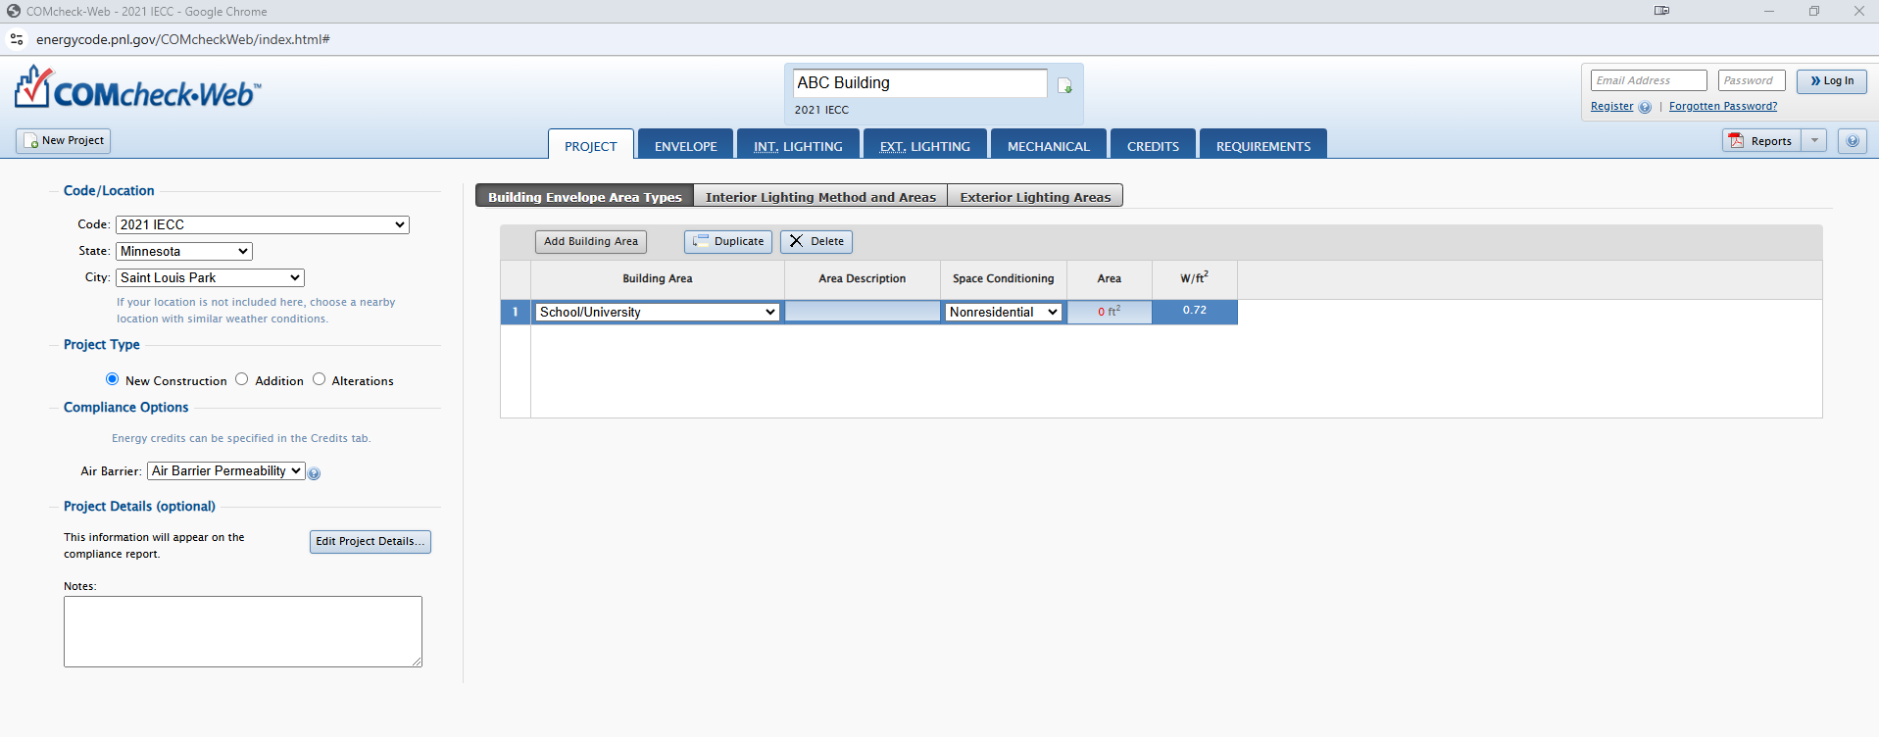
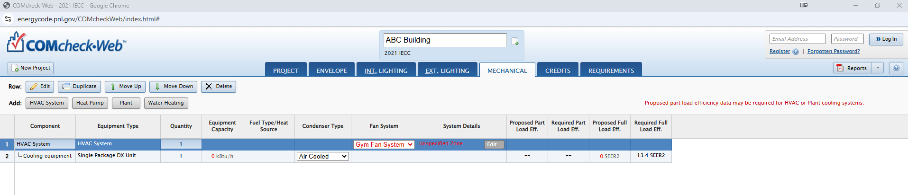
Checking Compliance

Slide 24
ASHRAE Standard 90.1-2019

Slide 25
Poll
ASHRAE Standard 90.1-2019 incorporates 89 addenda. What category incorporates the greatest number of changes?

Slide 26
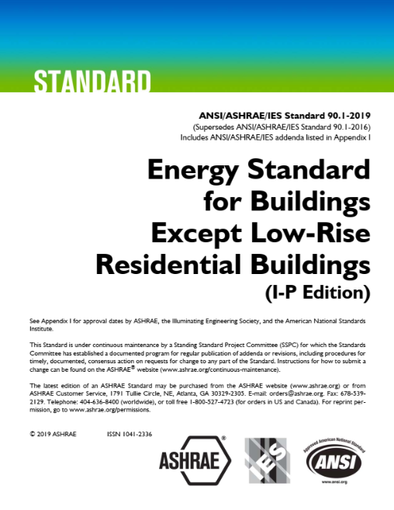
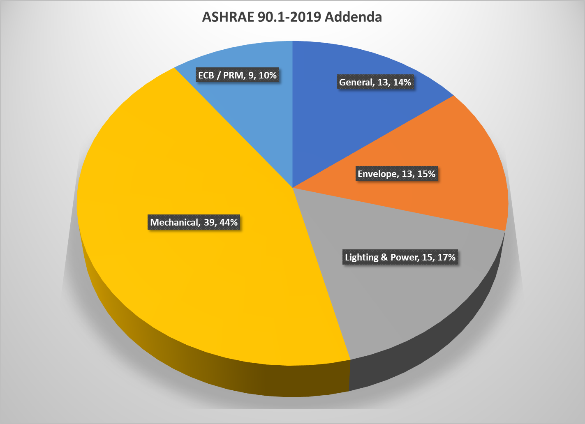
ASHRAE 90.1-2019
Incorporates 89 addenda

Slide 27
Commissioning

Slide 28
Commissioning Requirements
Commissioning Vastly Expanded in ASHRAE Standard 90.1-2019
Mandatory
!
  Commissioning is required for buildings that meet either of the following requirements:
    > 10,000 ft² of conditioned space
    Combined heating, cooling, and SWH capacities of > 960,000 BTU/h
  Notable Exceptions:
  Building/portions of buildings using the simplified approach option
  Dwelling units
  Non-refrigerated warehouses
  Per section 6.9.2, detailed HVAC commissioning instructions must be provided in the construction documents
New / expanded in ASHRAE Standard 90.1-2019

Slide 29
Commissioning Requirements
Documentation Requirements for Commissioning (4.2.5.2.1)
  Must be included in the building permit application
    Commissioning plan
    Commissioning provider identified
    Construction phase commissioning requirements
  Must be completed prior to building permit issuance
    Copy of commissioning plan submitted to owner
    Commissioning provider submits design review report to owner
  Document
    Clear specifications facilitate inspectors’ work, especially for code requirements

Slide 30
Building Envelope

Slide 31
Air Leakage (5.4.3)
Whole-Building Air Leakage Testing (5.4.3.1.1)
Mandatory
Whole-building pressurization testing must be conducted
Measured air leakage rate must not exceed:
    0.30 cfm/SF @ 0.2 in. of water for Group R or Group I occupancies
    0.40 cfm/SF @ 0.3 in. of water for all other occupancy types
Compliance should be shown separately for conditioned spaces and semi-heated spaces
Dwelling units shall be individual testing units; whole building air leakage shall be a weighted average of all individual testing units

Slide 32
Air Leakage (5.4.3)
Exceptions to Whole-Building Air Leakage Testing (5.4.3.1.1)
Mandatory
  Buildings over 50,000 ft² can conduct air leakage testing on less than the whole building
    Specific portions of the building still need to be tested
  If measured air leakage is between 0.40-0.60 cfm/ft², compliance can still be met if a diagnostic evaluation is conducted and identified leaks sealed
    A corrective action report must be submitted to the code official
  If a Group R or I building has 8 or more testing units, the greater of seven units or 20% of the units in the building shall be tested
    Sample must include a top floor unit, a ground floor unit, and the unit with the largest enclosure area
  Alternatively, a continuous air barrier design and installation verification program can be followed (5.9.1.2)
    Periodic field inspection of materials and assemblies during construction by 3rd-party
    Reporting shall comply with 4.2.5.1.2

Slide 33
Air Leakage (5.4.3)
Continuous Air Barrier (5.4.3.1.2)
Mandatory
  The exterior and semi-exterior building envelope must have a continuous air barrier extending over all surfaces of the building envelope
  Components designed to provide and support the barrier must be clearly identified on construction documents
  Barrier must be identified as continuous in the construction documents
  Must be designed to resist positive and negative pressures
  Specific areas must be wrapped, sealed, calked, gasketed, or otherwise sealed

Slide 34
Vestibules (5.4.3.3)
Vestibules and Revolving Doors (5.4.3.3)
Mandatory
  Maximum floor area of each vestibule is now specified as greater of 50 ft² or 2% of the gross conditioned floor area for that level of the building.
  Refined the exceptions and added a new option and associated criteria for using air curtains.
    Self-closing doors in buildings 15 stories or less that have an air curtain do not require a vestibule
    Air curtain requirements are detailed in 10.4.5 (door switches for air curtain control are required).

Slide 35
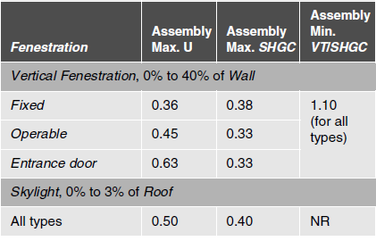
Prescriptive Compliance Path
Prescriptive Building Envelope Compliance Path (5.5)
Prescriptive
  Opaque elements and fenestration requirements have been revised to increase stringency while maintaining a reasonable level of cost-effectiveness (see Table 5.5-5 for Climate Zone 5).
  For vertical fenestration, “nonmetal framed” and “metal framed” products were combined.
  Minimum criteria for SHGC and U-factor were upgraded across all climate zones.
  Minimum VT/SHGC ratio was added for vertical fenestration to enable good daylighting with minimum solar gain (while not restricting triple and quadruple glazing).
  Skylight criteria was simplified.

Slide 36
Fenestration
Fenestration Orientation (5.5.4.5)
Prescriptive
  Neither west-facing nor east-facing windows can make up more than 25% of the total window area
  If west/east windows have an SHGC significantly lower than the maximum allowed, buildings can meet this requirement through the equation below:
  A_{W} × SHGC_{W} < (A_{T} × SHGC_{C})/5 and A_{E} × SHGC_{E} < (A_{T} × SHGC_{C})/5
Notable Exceptions:
  Street-level, street-side windows may be excluded (must meet criteria detailed in 5.5.4.4.1, Exception 3).
  Heavily- and permanently-shaded buildings (must meet criteria detailed in 5.5.4.5, Exception 2).
  Alterations and additions with no increase in vertical fenestration area.
  Each (E&W) façade’s window-to-wall ratio ≤20% and SHGC ≤ 90% of prescriptive.

Slide 37
Mechanical & HVAC

Slide 38
ASHRAE Standard 90.1 Mechanical Compliance Paths
Compliance Pathways
3 Options:
ASHRAE 90.1 Prescriptive Path
Simplified HVAC Approach (Section 6.3)
Mandatory + Prescriptive (Section 6.5)
Mandatory + Performance
    Energy Cost Budget Method (Section 11)
    Performance Rating Method (Appendix G)
Sections 5, 6, 7, 8, 9, and 10
w/ Envelope Trade-Off (Optional)
Prescriptive
Allows trade-offs within Section 5.5
w/ Simplified HVAC Approach (Optional)
Section 6.3 (alternative to 6.4 & 6.5)
ASHRAE 90.1-2019
ASHRAE 90.1 Energy Cost Budget Method
Section 11 and Mandatory Provisions¹
Performance
ASHRAE 90.1 Energy Performance Rating Method
Section 4.2.1(c), Appendix G and Mandatory Provisions¹

Slide 39
ASHRAE 90.1-2019 Mechanical Compliance Paths
Simplified HVAC Approach (Section 6.3)
  Allows buildings to comply with a simplified set of requirements (6.3.2) instead of the mandatory and prescriptive requirements of sections 6.4 & 6.5
  Can be used if:
    Building is 2 stories or fewer in height
    Gross floor area < 25,000 ft²
    Each HVAC system in building complies with section 6.3.2
    Project is not using performance path
  Requirements
    Simplified Provisions in Section 6.3.2 (including references to others)

Slide 40
ASHRAE 90.1-2019 Mechanical Compliance Paths
Mandatory (6.4)
Prescriptive (6.5)
  Required for buildings following the prescriptive or performance pathways
    Simplified approach is exempt
  Key mandatory provisions
    HVAC equipment sizing
    Heating and cooling system controls
    Economizer fault detection and diagnostics
    Demand control ventilation (DCV)
    HVAC equipment efficiencies
  Default pathway for buildings that do not follow the simplified approach or performance paths
  Requirements:
    Mandatory provisions (6.4)
    Prescriptive provisions (6.5)
  Key prescriptive measures:
    Door switches
    Occupied-standby controls
    Air economizers
    Energy recovery ventilation (ERV)
    Fan power limitation
    Multi-zone systems

Slide 41
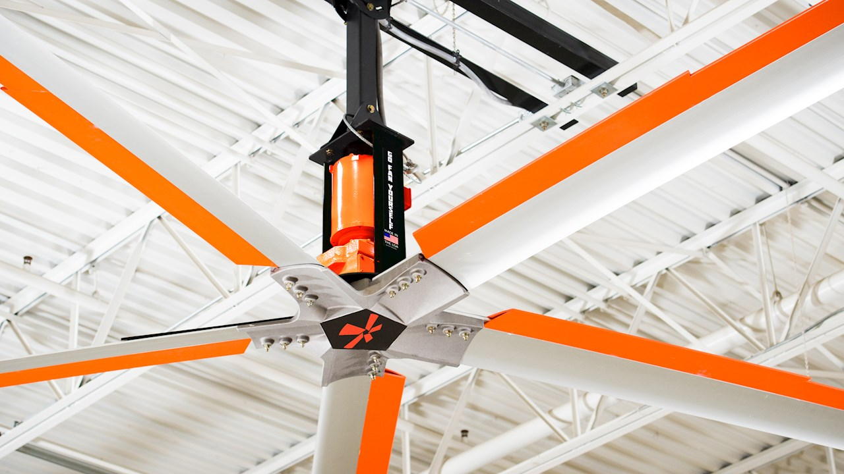
Mechanical System Equipment Requirements
Ceiling Fans (6.4.1.3)
Mandatory
!
  Large diameter ≥ 84.5 inches ceiling fans must be rated per¹:
    DOE 10 CFR 430 Appendix U
    AMCA 230
  Documented data to include:
    Blade diameter
    Rated airflow and power consumption at maximum speed
New in ASHRAE Standard 90.1-2019

Slide 42
Mechanical HVAC Equipment Requirements
Damper Leakage (6.4.3.4.3)
Mandatory
!
  Outdoor air supply and exhaust/relief dampers must have a maximum air leakage rate of:
    20 cfm/ft² at 1.0 in of water for non-motorized dampers
    4 cfm/ft² at 1.0 in of water for motorized dampers
  Document:
    In drawing notes, especially on mechanical schedules
    Specifications for HVAC units and/or controls
    On inspections, typically see non-metal material on damper ends
New in ASHRAE Standard 90.1-2019

Slide 43
Mechanical HVAC Equipment Requirements
Duct Sealing (6.4.4.2.1)
Mandatory
!
Ducts and plenums with pressure class ratings must be constructed to Seal Class A
Document:
  Ideally in general notes on plans
  In specifications is adequate
What to seal:
  Longitudinal seams
  Transverse joints
  Connections
  Supply & return ducts
How to seal:
  Mastics
  Welds
  Gaskets
  Mastic + embedded fabric systems
  Tapes (ASHRAE requires compliance with UL-181A or UL-181B)
New in ASHRAE Standard 90.1-2019

Slide 44
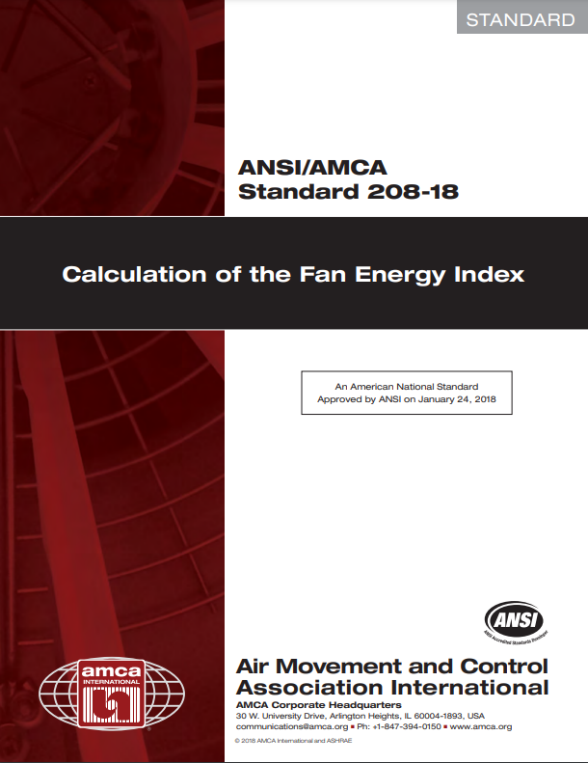
Mechanical HVAC Equipment Requirements
Fan Efficiency (6.5.3.1.3)
Prescriptive
!
  Requires a minimum fan energy index¹
    Constant speed: FEI ≥ 1.00
    VAV: FEI ≥ 0.95
  Notable Exceptions:
  Non-embedded fans smaller than 1.0 hp/0.89 kW
  Embedded fans and arrays smaller than 5 hp/4.1 kW
  Embedded fans that are part of equipment listed under Section 6.4.1.1 or bearing a third-party-certified seal for air or energy performance of the equipment package
  Ceiling fans
  Fans intended to only operate during emergencies
  Replaces Fan Efficiency Grade (FEG) with Fan Energy Index (FEI)
    FEG required peak efficiency
    FEI requires optimal performance at scheduled operating point
New in ASHRAE Standard 90.1-2019

Slide 45
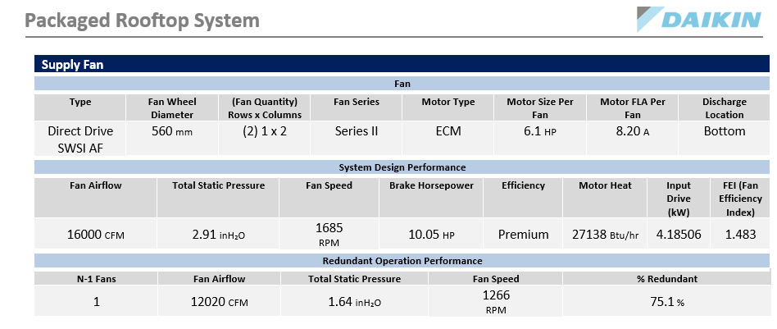
Mechanical HVAC Equipment Requirements
FEI in DST

Slide 46
Mechanical HVAC Equipment Requirements
Boiler Efficiency – Buildings with High-Capacity Space Heating Gas Boiler Systems (6.5.4.8.1)
Prescriptive
!
  Large systems (design input 1,000,000 to 10,000,000 Btu/h) in new buildings shall have a minimum thermal efficiency of 90%¹
    Use weighted average for multi-boiler systems (exclude boilers < 300,000 Btu/h)
  Notable Exceptions:
  Where 25% of heating is provided by on-site renewables, site-recovered energy, or heat recovery chillers
  Space heating boilers in individual dwelling units
  Where ≥ 50% of heating load serves perimeter convective heating and/or radiant ceiling panels
New in ASHRAE Standard 90.1-2019

Slide 47
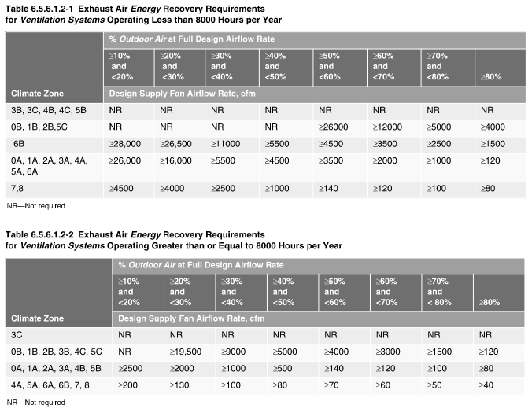
Mechanical HVAC Equipment Requirements
Energy Recovery Ventilation (6.5.6.1)
Prescriptive
!
  Non-transient dwelling units with >750 ft² of conditioned area¹:
    Must have outdoor air ERV systems that result in an enthalpy recovery ratio of ≥60% at heating design conditions
  All other spaces:
    Must have an energy recovery system if system is above supply air flowrate indicated in Tables 6.5.6.1.2-1 and 6.5.6.1.2-2
    Must provide an enthalpy recovery ratio of ≥50% at heating and cooling design conditions
New in ASHRAE Standard 90.1-2019
Source: ASHRAE Standard 90.1-2019

Slide 48
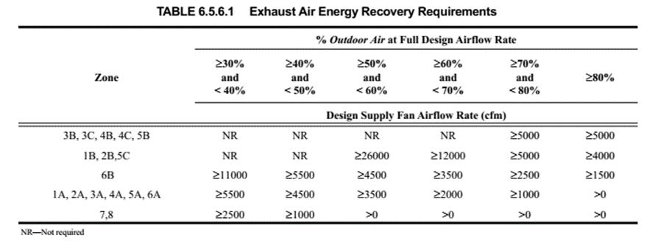
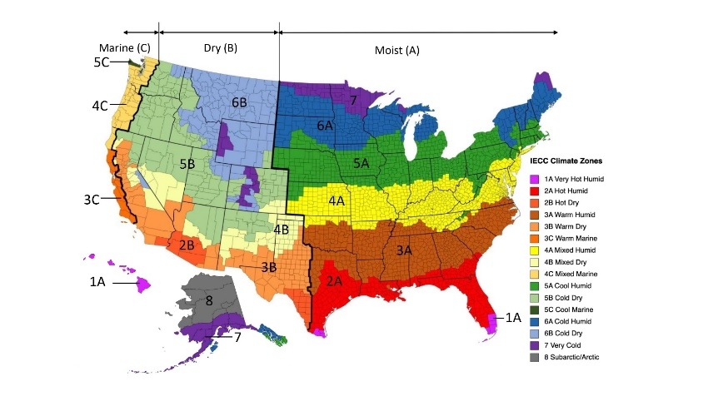
Mechanical HVAC Equipment Requirements
Energy Recovery Ventilation (6.5.6.1)
Prescriptive
2010
2019
!
Source: ASHRAE Standard 90.1-2019

Slide 49
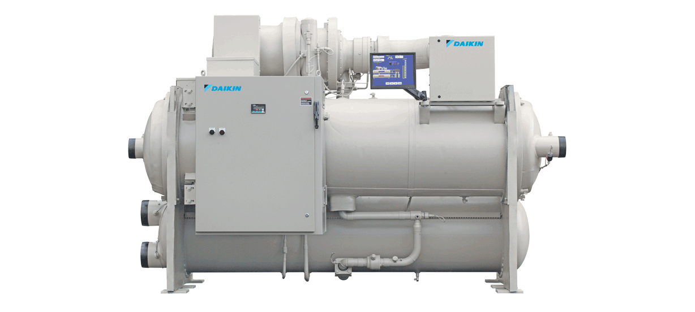
Mechanical HVAC Equipment Requirements
Energy Recovery Chillers for Hospitals (6.5.6.3)
Mandatory
!
  Condenser heat recovery required for acute care inpatient hospitals, where:¹
    Operate 24-hour basis
    Design cooling capacity > 300T
    Simultaneous heating and cooling occurs above 60°F
New in ASHRAE Standard 90.1-2019

Slide 50
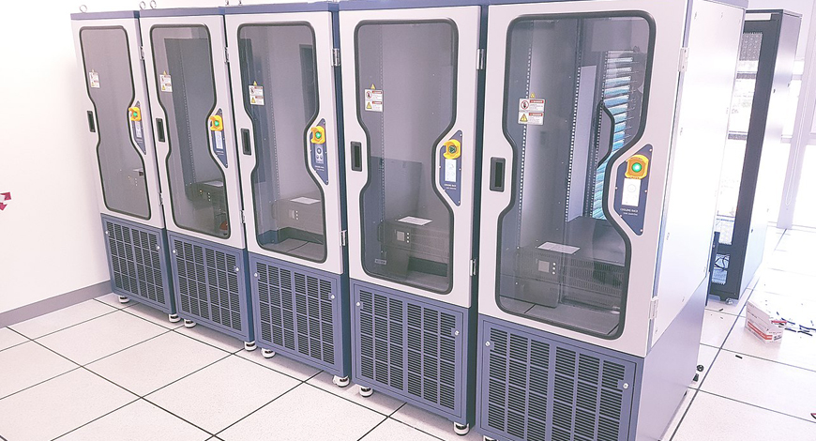
ASHRAE 90.1-2019 Mechanical Compliance Paths
Computer Rooms & Data Centers (6.6.1)
!
  New requirements allow the option of using ASHRAE Standard 90.4- 2019, Energy Standard for Data Centers
    Instead of ASHRAE Standard 90.1
    In computer rooms that have an IT equipment load greater than 10 kW
    Apply ASHRAE Standard 90.4 electrical efficiency requirements
New in ASHRAE Standard 90.1-2019

Slide 51
Mechanical HVAC Equipment Requirements
Minimum Efficiency Requirements for HVAC Equipment (6.8.1)
Mandatory
Equipment listed in the 6.8.1 tables must meet the minimum performance at the specified rating conditions identified in the appropriate table
Tables include:
  Electrically Operated Unitary Air Conditioners and Condensing units
  Electrically Operated Air-Cooled Unitary Heat Pumps
  Water-Chilling Packages
  Electrically Operated Packaged Terminal Air Conditioners, Packaged Terminal Heat
  Pumps, Single-Package Vertical Air Conditioners
  Single Package Vertical Heat Pumps, Room Air Conditioners, and Room Air Conditioner Heat Pumps
  Warm-Air Furnaces and Combination Warm-Air Furnaces/Air-Conditioning Units, Warm-Air Duct Furnaces and Unit heaters
  Gas- and Oil-Fired Boilers
  Heat Rejection-Equipment
  Electrically Operated Variable-Refrigerant-Flow Air Conditioners
  Electrically Operated Variable-Refrigerant Flow and Applied Heat Pumps
  Floor-Mounted Air Conditioners and Condensing Units Serving Computer Rooms
  Commercial Refrigerators, Commercial Freezers, and Refrigeration
  Vapor-Compression-Based Indoor Pool Dehumidifiers
  Electrically Operated DX-DOAS Units, Single Package and Remote Condenser, without Energy Recovery
  Electrically Operated DX-DOAS Units, Single Package and Remote Condenser, with Energy Recovery
  Electrically Operated Water-Source Heat Pumps¹
  Heat Pump and Heat Recovery Chiller Packages¹
  Ceiling-Mounted Computer-Room Air Conditioners¹
  Walk-In Cooler and Freezer Display Door¹
  Walk-In Cooler and Freezer Non-display Door¹
  Walk-In Cooler and Freezer Refrigeration System¹
!
New in ASHRAE Standard 90.1-2019

Slide 52
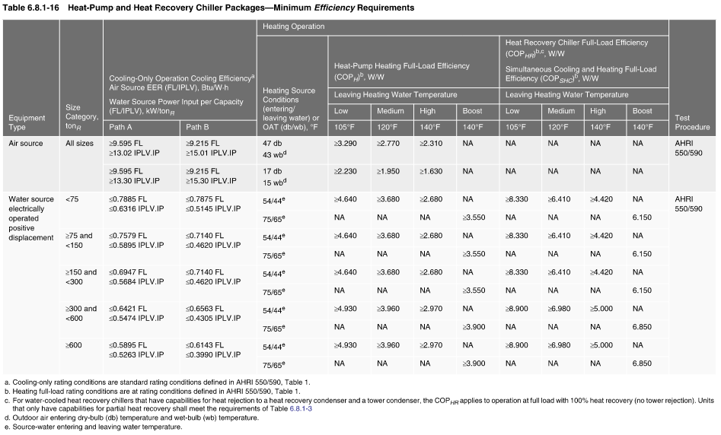
Mechanical HVAC Equipment Requirements

Slide 53
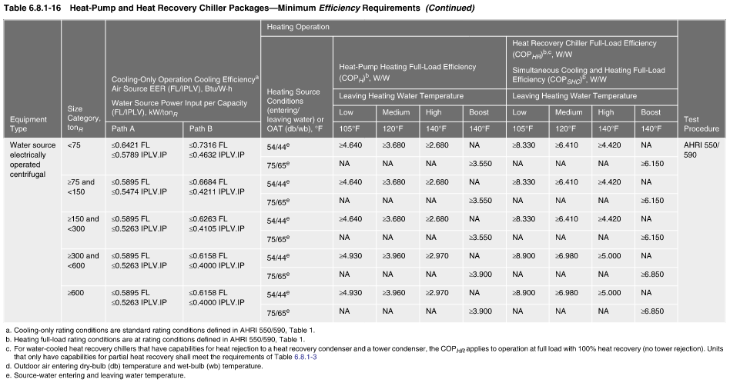
Mechanical HVAC Equipment Requirements

Slide 54

Mechanical System Control Requirements
ASHRAE Guideline 36
  Starting to incorporate ASHRAE Guideline 36 recommendations
  Expanding scope of controls requirements in ASHRAE Standard 90.1
  For example:
    Reheat limitations
    Supply air temperature reset sequences

Slide 55
Mechanical System Control Requirements
Summary of Control Requirements
Requirement | Mandatory / Prescriptive | Description
Dead Band (6.4.3.1.2) | Mandatory | Zone thermostatic controls that automatically switchover between heating and cooling must be configured to provide a temperature range of at least 5ºF between heating and cooling setpoints
Scheduling On/Off (6.4.3.3.1) | Mandatory | HVAC systems must be equipped with controls that can start and stop the system by using one of the following methods: Different time schedules for seven different day types per week Occupancy sensor control (up to 30 minutes) Manually operated timer (up to 2 hours) Interlock to a security system
Setback Controls (6.4.3.3.2) | Mandatory | Applies to zones using the Ventilation Rate Procedure that: Serve only rooms that are required to have automatic off lighting controls (partial or full) Are permitted per ASHRAE 62.1 to have ventilation air reduced to zero when the space is in occupied-standby mode per ASHRAE 62.1 Within 5 minutes of zone entering occupied-standby mode, systems must: Set back/set up active heating and cooling setpoints at least 1ºF Shut off all supplied airflow when temperature is between set points

Slide 56
Mechanical System Control Requirements
Summary of Control Requirements
Requirement | Mandatory / Prescriptive | Description
Optimum Start (6.4.3.3.3) | Mandatory | Heating and cooling systems with setback controls and direct digital control (DDC) must have optimum start controls, where the control algorithm is a function of: Difference between space temperature and occupied set point Outdoor temperature Amount of time prior to scheduled occupancy Floor temperature (mass radiant floor slab systems only)
Demand Control Ventilation (6.4.3.8) | Mandatory | Provides automatic reduction of outdoor air intake below design when occupancy is less than design Typically done by sensing carbon dioxide Required for spaces: Larger than 500 ft² With a design occupancy for ventilation of greater than 25 people per 1000 ft² If the space is served by systems that have one or more of the following: Air economizer Automatic modulating control of outdoor air damper Design outdoor airflow greater than 3,000 cfm

Slide 57
Mechanical System Control Requirements
Summary of Control Requirements
Requirement | Mandatory / Prescriptive | Description
Economizer Fault Detection and Diagnostics (6.4.3.12) | Mandatory | Air-cooled DX expansion cooling units with economizers must include a FDD system complying with the provisions of 6.4.3.12, including: Temperature sensors for monitoring and displaying systems operation System status indicators Ability to manually initiate each operating mode Fault detection & reporting capabilities
Supply Fan Airflow Control (6.4.5.2.1) | Prescriptive | For DX and chilled-water units that control cooling capacity directly based on space temperature: Minimum of two stages of fan control Minimum speed ≤ 66% of full speed For all other units (including DX and chilled-water units that control space temperature through airflow modulation): Modulating fan control Minimum speed ≤ 66% of full speed Units with economizers need to have a minimum of two speeds of fan control during economizer operation
Economizer High Limit Shutoff (6.5.1.1.3) | Prescriptive | All air economizers must reduce OA intake to the design minimum OA quantity when the OA intake will no longer reduce cooling energy use.

Slide 58
Mechanical System Control Requirements
Summary of Control Requirements
Requirement | Mandatory / Prescriptive | Description
Door Switches (6.5.10) | Prescriptive | Conditioned space with doors opening to the outdoors shall be provided with controls that do the following within 5 minutes of the door opening: Disable or reset heating set point to 55ºF or lower Disable or reset cooling set point to 90ºF or greater
Supply Fan Airflow Control (6.5.3.2.1) | Prescriptive | Certain cooling systems must be designed to vary the supply fan airflow as a function of load DX cooling systems with cooling capacity ≥ 65,000 Btu/h Chilled-water and evaporative cooling systems with fan motor power ≥ 1/4 hp
Supply Fan Temperature Reset Controls (6.5.3.5) | Prescriptive | Multi-zone HVAC systems shall include controls that automatically reset the supply air temperature in response to building loads or OA temperature Controls shall reset supply air temperature at least 25% of the difference between design supply air temperature and design room temperature
Occupied-Standby Controls (6.5.3.8) | Mandatory | Within 5 minutes of zone entering occupied-standby mode, systems must: Set back/set up active heating and cooling setpoints at least 1ºF Shut off all supplied airflow when temperature is between set points
Service Hot Water Recirculation Systems (7.4.4.2) | Mandatory | Recirculating hot-water or heat trace systems must be able to switch off usage temperature maintenance system when hot water is not required Automatic time switches or other controls Typically applies to multifamily projects

Slide 59
Mechanical System Control Requirements: Space Temperature Control
Dead Band (6.4.3.1.2)
Mandatory
  Zone thermostatic controls that automatically switchover between heating and cooling must be configured to provide a temperature range of at least 5ºF between heating and cooling setpoints
  Notable Exceptions:
  Retirement homes
  Process applications
  Museums
  Some areas of hospitals

Slide 60
Mechanical System Control Requirements: Space Temperature Control
Scheduling On/Off (6.4.3.3.1)
Mandatory
  HVAC systems must be equipped with controls that can start and stop the system by using one of the following methods:
    Different time schedules for seven different day types per week
    Occupancy sensor control (up to 30 minutes)
    Manually operated timer (up to 2 hours)
    Interlock to a security system
  Notable Exceptions:
  Residential occupancies may utilize two different time schedules per week

Slide 61
Mechanical System Control Requirements: Space Temperature Control
Setback Controls (6.4.3.3.2)
Mandatory
  Heating and cooling systems must be equipped with controls capable and configured to automatically adjust the temperature setpoint during periods of unoccupancy.
    Heating setback: 10ºF below occupied heating setpoint
    Cooling setback: 5ºF above occupied cooling setpoint (or to a level that prevents high space humidity levels)
  Notable Exceptions:
  Radiant heating systems with a heating setback of at least 4ºF

Slide 62
Mechanical System Control Requirements: Space Temperature Control
Optimum Start (6.4.3.3.3)
Mandatory
  Heating and cooling systems with setback controls and direct digital control (DDC) must have optimum start controls, where the control algorithm is a function of:
    Difference between space temperature and occupied set point
    Outdoor temperature
    Amount of time prior to scheduled occupancy
    Floor temperature (mass radiant floor slab systems only)

Slide 63
Mechanical System Control Requirements: Ventilation
Demand Control Ventilation (6.4.3.8)
Mandatory
  Provides automatic reduction of outdoor air intake below design when occupancy is less than design
    Typically done by sensing carbon dioxide
  Document:
    Sequence of operations
    Specifications for HVAC units and/or HVAC controls
    CO₂ sensor notes on drawings
  Required for spaces:
    Larger than 500 ft²
    With a design occupancy for ventilation of greater than 25 people per 1000 ft²
  If the space is served by systems that have one or more of the following:
    Air economizer
    Automatic modulating control of outdoor air damper
    Design outdoor airflow greater than 3,000 cfm

Slide 64
Mechanical System Control Requirements: Ventilation
Demand Control Ventilation Exceptions (6.4.3.8)
Mandatory
  Not required for:
    Systems with exhaust air energy recovery in compliance with Section 6.5.6.1
    Multi-zone systems without DDC
    Systems with a design outdoor airflow (OA) less than 750 cfm
    Spaces where greater than 75% of OA required for makeup or transfer air
  Not required for spaces with the following ASHRAE Standard 62.1 occupancy categories:
    Correctional cells
    Daycare sickrooms
    Science labs
    Barbers
    Beauty and nail salons
    Bowling alley seating

Slide 65
Mechanical System Control Requirements
Economizer Fault Detection and Diagnostics (6.4.3.12)
Mandatory
  Air-cooled DX expansion cooling units with economizers must include a FDD system complying with the provisions of 6.4.3.12.
  Notable provisions include:
    Temperature sensors for monitoring and displaying systems operation
    System status indicators
    Ability to manually initiate each operating mode
    Fault detection & reporting capabilities

Slide 66
Mechanical System Control Requirements
Supply Fan Airflow Control (6.4.5.2.1)
Prescriptive
  For DX and chilled-water units that control cooling capacity directly based on space temperature:
    Minimum of two stages of fan control
    Minimum speed ≤ 66% of full speed
  For all other units (including DX and chilled-water units that control space temperature through airflow modulation):
    Modulating fan control
    Minimum speed ≤ 66% of full speed
    Units with economizers need to have a minimum of two speeds of fan control during economizer operation

Slide 67
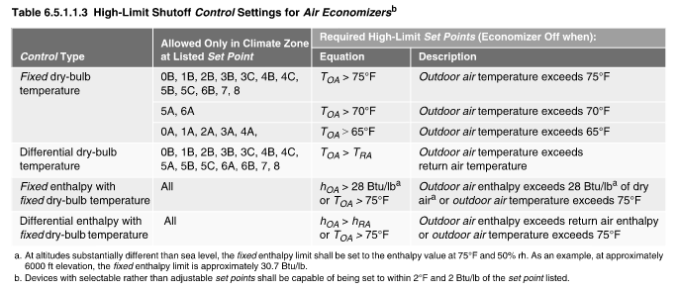
Mechanical System Control Requirements
Economizer High Limit Shutoff (6.5.1.1.3)
Prescriptive
  All air economizers must reduce OA intake to the design minimum OA quantity when the OA intake will no longer reduce cooling energy use. Control types and set points by climate zone are shown in Table 6.5.1.1.3 (below).

Slide 68
Mechanical System Control Requirements: Space Temperature Control
Door Switches (6.5.10)
Prescriptive
  Conditioned space with doors opening to the outdoors shall be provided with controls that do the following within 5 minutes of the door opening:
    Disable or reset heating set point to 55ºF or lower
    Disable or reset cooling set point to 90ºF or greater
    Cooling may remain enabled if outdoor air temperature is below space temperature
  Notable Exceptions:
  Building entries with automatic closing devices
  Any space without a thermostat
  Alterations to existing buildings
  Loading docks

Slide 69
Mechanical System Control Requirements
Supply Fan Airflow Control (6.5.3.2.1)
Prescriptive
  Certain cooling systems must be designed to vary the supply fan airflow as a function of load
    DX cooling systems with cooling capacity ≥ 65,000 Btu/h
    Chilled-water and evaporative cooling systems with fan motor power ≥ 1/4 hp
  Notable Exceptions:
  Modulating fan control not required for chilled-water/evaporative units with fan motor power< 1 hp if units do not provide ventilation air and indoor fan cycles with the load
  If OA volume required by ASHRAE 62.1 exceeds the air that would be delivered at the minimum speed, then minimum speed should be set at the minimum speed that delivers enough OA to meet the required ventilation

Slide 70
Mechanical System Control Requirements
Supply Fan Temperature Reset Controls (6.5.3.5)
Prescriptive
  Multi-zone HVAC systems shall include controls that automatically reset the supply air temperature in response to building loads or OA temperature
  Controls shall reset supply air temperature at least 25% of the difference between design supply air temperature and design room temperature
  Notable Exceptions:
  Systems that prevent reheating, recooling, or mixing of heated and cooled supply air
  Systems in which at least 75% of the energy for reheating is from site recovered energy or site-solar energy

Slide 71
Mechanical System Control Requirements: Space Temperature Control
Occupied-Standby Controls (6.5.3.8)
Mandatory
  Applies to zones using the Ventilation Rate Procedure that:
    Serve only rooms that are required to have automatic off lighting controls (partial or full)
    Are permitted per ASHRAE 62.1 to have ventilation air reduced to zero when the space is in occupied-standby mode per ASHRAE 62.1
  Within 5 minutes of zone entering occupied-standby mode, systems must:
    Set back/set up active heating and cooling setpoints at least 1ºF
    Shut off all supplied airflow when temperature is between set points
Notable Exceptions:
  Multiple zone systems without automatic zone flow control dampers

Slide 72
Mechanical System Control Requirements
Service Hot Water Recirculation Systems (7.4.4.2)
Mandatory
  Recirculating hot-water or heat trace systems must be able to switch off usage temperature maintenance system when hot water is not required
  Automatic time switches or other controls
  Typically applies to multifamily projects

Slide 73
Mechanical System Control Requirements
Summary of Mechanical System Control Requirements
Dead Band (6.4.3.1.2)
Scheduling On/Off (6.4.3.3.1)
Setback Controls (6.4.3.3.2)
Optimum Start (6.4.3.3.3)
Demand Control Ventilation (6.4.3.8)
Economizer Fault Detection and Diagnostics (6.4.3.12)
Supply Fan Airflow Control (6.4.5.2.1)
Economizer High Limit Shutoff (6.5.1.1.3)
Door Switches (6.5.10)
Supply Fan Airflow Control (6.5.3.2.1)
Supply Fan Temperature Reset Controls (6.5.3.5)
Occupied-Standby Controls (6.5.3.8)
Service Hot Water Recirculation Systems (7.4.4.2)
Increased scope and depth of controls requirements!

Slide 74
Mechanical HVAC Equipment Requirements
Pool Covers (7.4.5.2)
Mandatory
!
  Heated pools must have a vapor-retardant pool cover
  Covers on pools heated >90ºF must have a minimum thermal resistance value of R-12
  Pools deriving over 60% of their energy from site-recovered or site-solar energy are exempt from these requirements
New in ASHRAE Standard 90.1-2019

Slide 75
Electrical, Lighting & Power

Slide 76
ASHRAE 90.1-2019 Energy Monitoring
!
Electrical Energy Monitoring (8.4.3)
  Measurement devices in new buildings to monitor electrical energy use of:
    Total electrical energy
    HVAC systems
    Interior lighting
    Exterior lighting
    Receptacle circuits
  Up to 10 percent of the load for each of the subcategories may be miscategorized
  Buildings with tenants must monitor each tenant area separately
  Record energy use at a minimum of every 15 minutes
  Maintain data history for a minimum of 36 months
  Reporting intervals include hourly, daily, monthly and annual
New in ASHRAE Standard 90.1-2019

Slide 77
ASHRAE 90.1-2019 Energy Monitoring
!
Whole-Building Energy Monitoring (10.4.6)
  Measurement devices in new buildings to monitor usage of:
    Natural gas
    Fuel oil
    Propane
    Steam
    Chilled water
    Hot water
  Record energy use at a minimum of every 60 minutes
  Maintain data history for a minimum of 36 months
  Reporting intervals include hourly, daily, monthly and annual, for energy consumption and demand
New in ASHRAE Standard 90.1-2019

Slide 78
ASHRAE 90.1-2019 Energy Monitoring
!
Electrical Energy and Whole-Building Energy Monitoring (8.4.3 & 10.4.6)
  Exceptions to the monitoring requirements:
    Buildings less than 25,000 ft²
      Whole-building utility monitoring (not electrical) also excludes additions less than 25,000 ft²
    Individual tenant spaces less than 10,000 ft²
    Dwelling units
    Residential buildings with less than 10,000 ft² of common area
    Critical and Equipment branches of NEC Article 517 (electrical monitoring only)
    Fuel used for on-site emergency equipment
New in ASHRAE Standard 90.1-2019

Slide 79
ASHRAE 90.1-2019 Lighting Compliance Paths
!
Simplified Lighting Approach (Section 9.3)
  Allows buildings to comply with a simplified set of requirements instead of the requirements of section 9.4, 9.5, or 9.6
  Projects must be:
    Less than 25,000 ft²
    Office buildings, retail buildings, or schools (at least 80% of floor area)
  Key differences from prescriptive
    Amends control requirements for certain equipment/applications
    Amends interior and exterior lighting power allowance for a simplified list of spaces
New in ASHRAE Standard 90.1-2019

Slide 80
ASHRAE 90.1-2019 Lighting Controls
!
Lighting Controls (Section 9.4.1)
  Parking garages
    Dimming reduction and time interval
  Interiors
    Continuous daylight dimming
    Daylighting
      Sidelighting
      Under skylights
  Special applications
    For example, lighting integral to open and enclosed refrigerator and freezer cases
New in ASHRAE Standard 90.1-2019

Slide 81
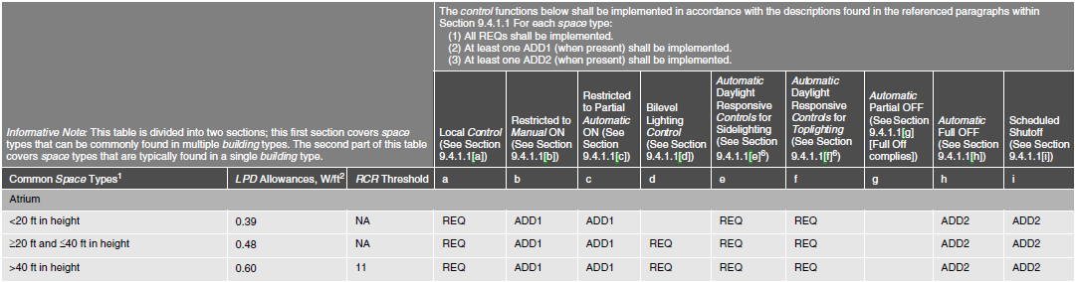
ASHRAE 90.1-2019 Lighting Controls
!
Lighting Controls (Table 9.6.1)
New in ASHRAE Standard 90.1-2019

Slide 82
ASHRAE 90.1-2019 Lighting Model & Compliance Paths
!
Updated Lighting Model¹
  Updated per IES recommendations
  100% LED baseline
  Average lighting power density reduction: 5%
  Building Area Method (9.5.1)
  Space by Space Method (9.6.1)
Space Type | 2016 | 2019
Office | 0.79 | 0.64
Hotel/motel | 0.75 | 0.56
Manufacturing | 0.90 | 0.82
Parking garage | 0.15 | 0.18
Retail | 1.06 | 0.84
School/University | 0.81 | 0.72
Warehouse | 0.48 | 0.45
Space Type | 2016 | 2019
Office, open plan | 0.81 | 0.61
Guest room | 0.77 | 0.41
Lobby, hotel | 1.06 | 0.51
Parking area | 0.14 | 0.15
Retail sales | 1.22 | 1.05
Classroom | 0.92 | 0.71
Warehouse | 0.35 | 0.33
Updated in ASHRAE Standard 90.1-2019

Slide 83
Performance Path

Slide 84

ASHRAE 90.1-2019 Performance Path Changes
ECB (Section 11) & PRM (Appendix G)
  Recharging and refueling vehicles
    Energy not included when calculating proposed building energy cost
  On-site electricity generation
    Baseline includes same generation system, but without heat recovery
  Lighting changes
  Simulation tools must be tested to ASHRAE Standard 140 with additional documentation requirements

Slide 85
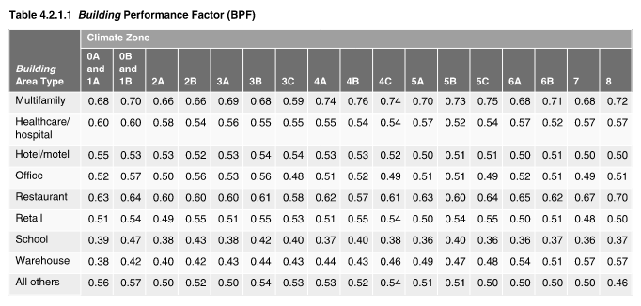
ASHRAE 90.1-2019 Performance Path Changes
ECB (Section 11)
PRM (Appendix G)
  Improved alignment with Appendix G
    Through numerous changes and additions
  Updated baseline for consistency with prescriptive requirements
  Refined baseline definition
  Applied limits to renewable energy tradeoffs
  Updated Building Performance Factors
    BPFs represent the energy cost ratio of Standard 90.1-2019/Standard 90.1-2004, and are updated with each new edition of ASHRAE Standard 90.1

Slide 86
ASHRAE Standard 90.1-2022
Preview

Slide 87
About ASHRAE 90.1
ASHRAE Standard 90.1, Energy Standard for Buildings Except Low-Rise Residential Buildings, specifies minimum requirements for energy efficient designs for buildings except for low-rise residential buildings.
ASHRAE Standard 90.1 defines two paths to comply:
Prescriptive, with requirements for building envelope, HVAC, domestic hot water, power, lighting, and other equipment
Performance-based, with two approaches, the Energy Cost Budget (ECB, Section 11) method, and the Performance Rating Method (PRM, Appendix G)
Latest version is 90.1-2022.
ASHRAE 90.1-2022 presentation coming soon . . .

Slide 88
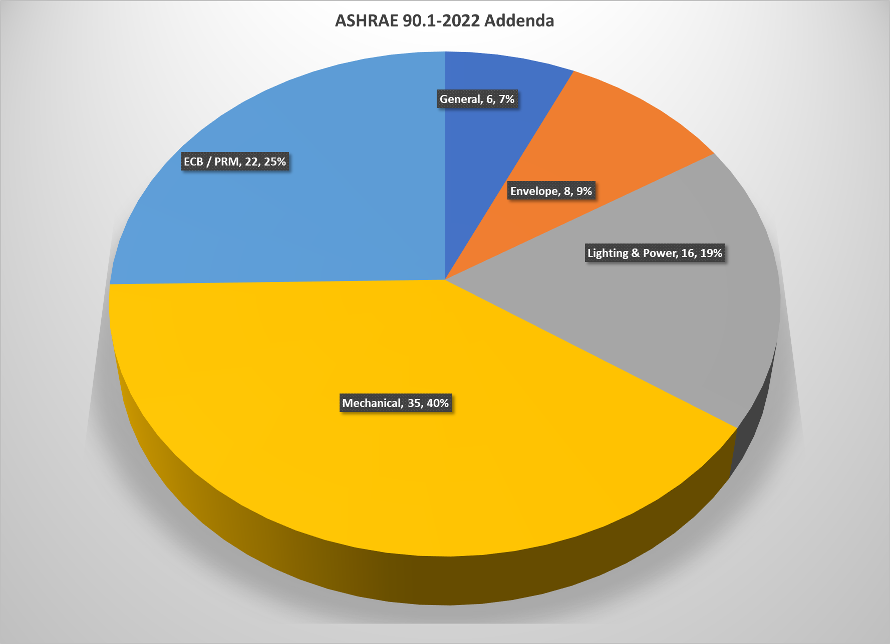
ASHRAE 90.1-2022
Incorporates 95 addenda

Slide 89
ASHRAE 90.1-2022

Slide 90
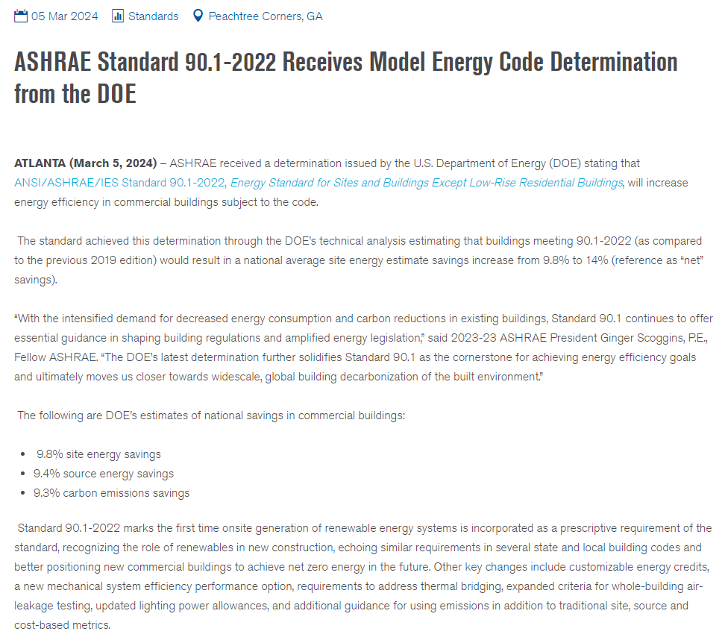
ASHRAE 90.1-2022

Slide 91
Resources

Slide 92
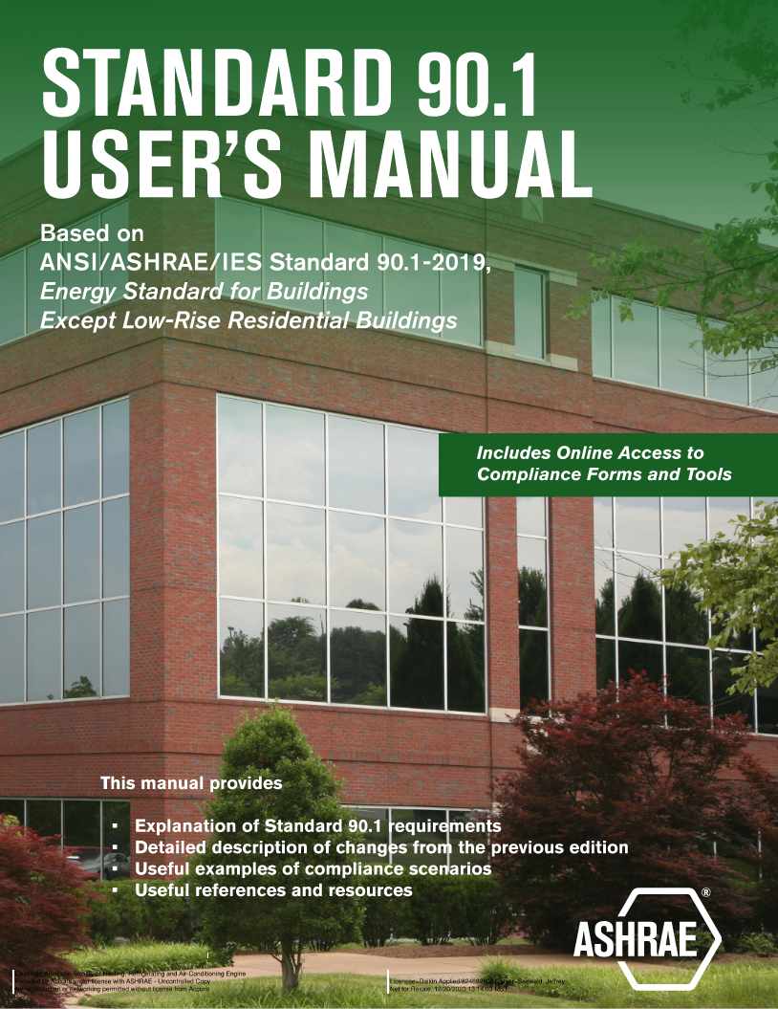
ASHRAE 90.1-2019 Resources
ASHRAE
  Standards
    Preview standards here: https://ashrae.org/technical-resources/standards-and-guidelines
    Preview popular and code-referenced standards here: https://www.ashrae.org/technical-resources/standards-and-guidelines/read-only-versions-of-ashrae-standards
  User Manual

Slide 93

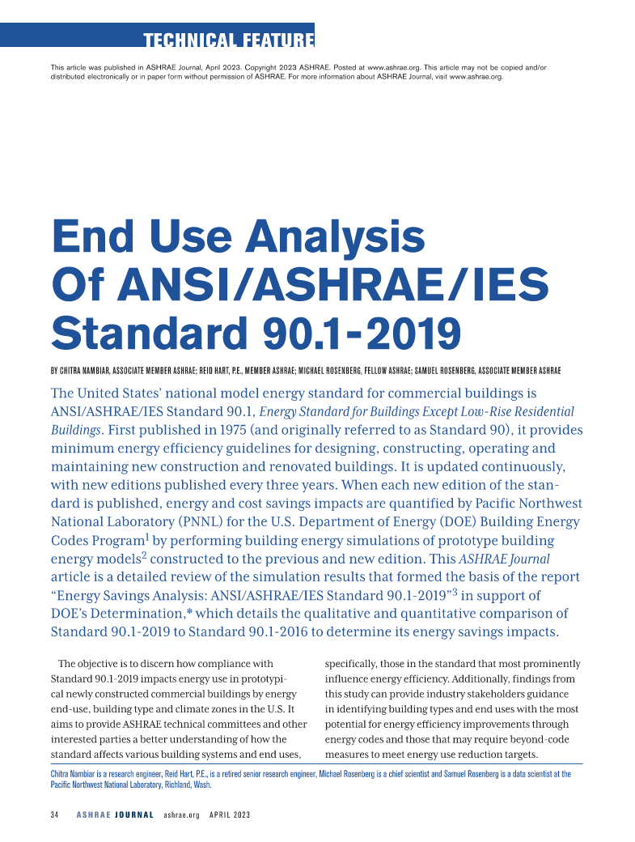
ASHRAE 90.1-2019 Resources
ASHRAE
  ASHRAE Journal
    A Conversation on Standard 90.1-2019
    End Use Analysis Of ANSI/ASHRAE/IES Standard 90.1-2019

Slide 94
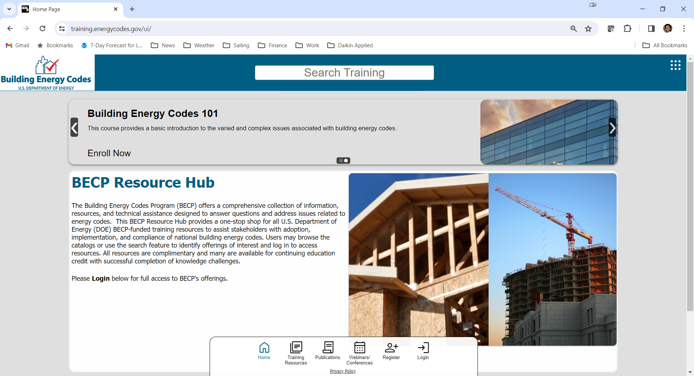

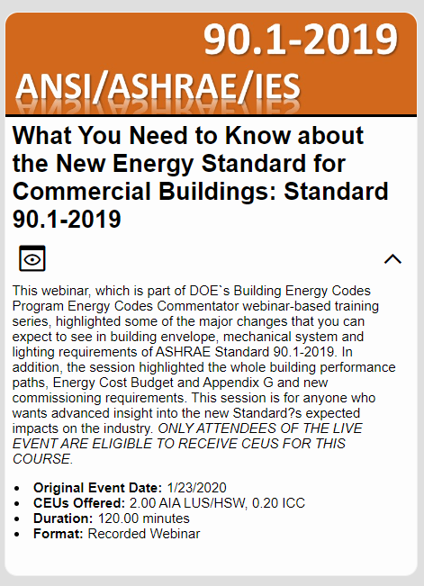
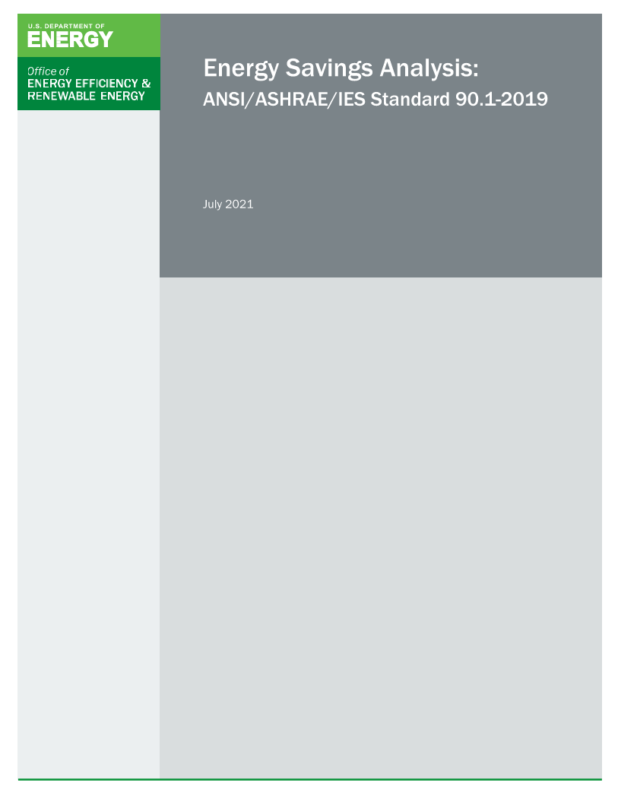
ASHRAE 90.1-2019 Resources
US Department of Energy
  Office of Energy Efficiency & Renewable Energy
    Building Energy Codes Program
  Energy Savings Analysis: ANSI/ASHRAE/IES Standard 90.1-2019

Slide 95
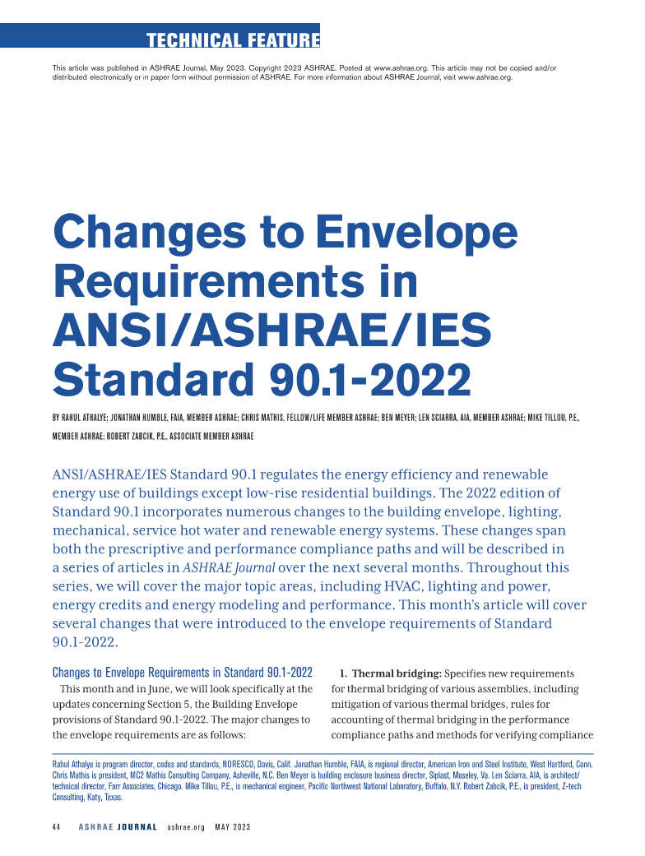
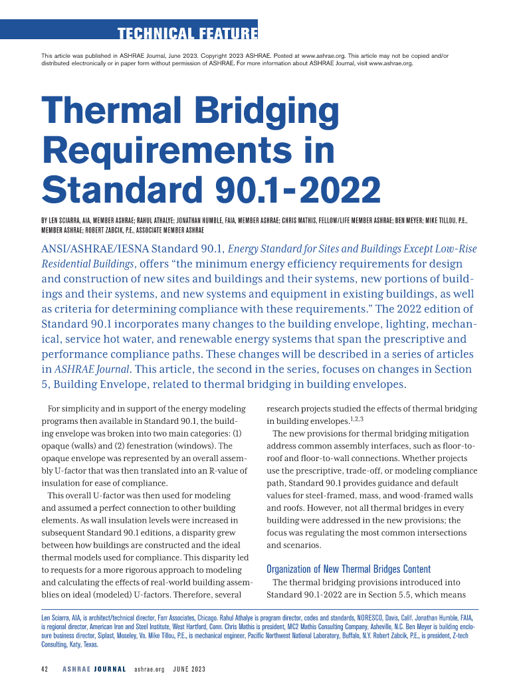

ASHRAE 90.1-2022 Resources
ASHRAE
  ASHRAE Journal Series
    Envelope
    Thermal Bridging
    Mechanical, Part 1
    Energy credits
    Lighting
    Mechanical, Part 2
    Performance path

Slide 96

ASHRAE 90.1-2022 Resources
US Department of Energy
  Office of Energy Efficiency & Renewable Energy
    Building Energy Codes Program
    BECP 2023-2024 Energy Code Webinar Series

Slide 97

Questions & Key Takeaways
Key Takeaways
Several states updated the basis of their building energy codes to ASHRAE 90.1-2019
Commissioning requirements are substantially expanded
Envelope
  Whole building air leakage testing
  Continuous air barrier
Simplified approach for small buildings
  HVAC
  Lighting
Mechanical
  Across the board updated equipment efficiencies
Lighting
  Decreased lighting power density
  100% LED baseline
Increased scope and depth of controls requirements

Slide 98
Thank you for your time and attention
For more information, contact:
Jeff Seewald
jeffrey.seewald@daikinapplied.com

